Slide 1
Illinois Animal Shelter dataset 2010-2014
Jim Cloud and Dick Xu

Slide 2
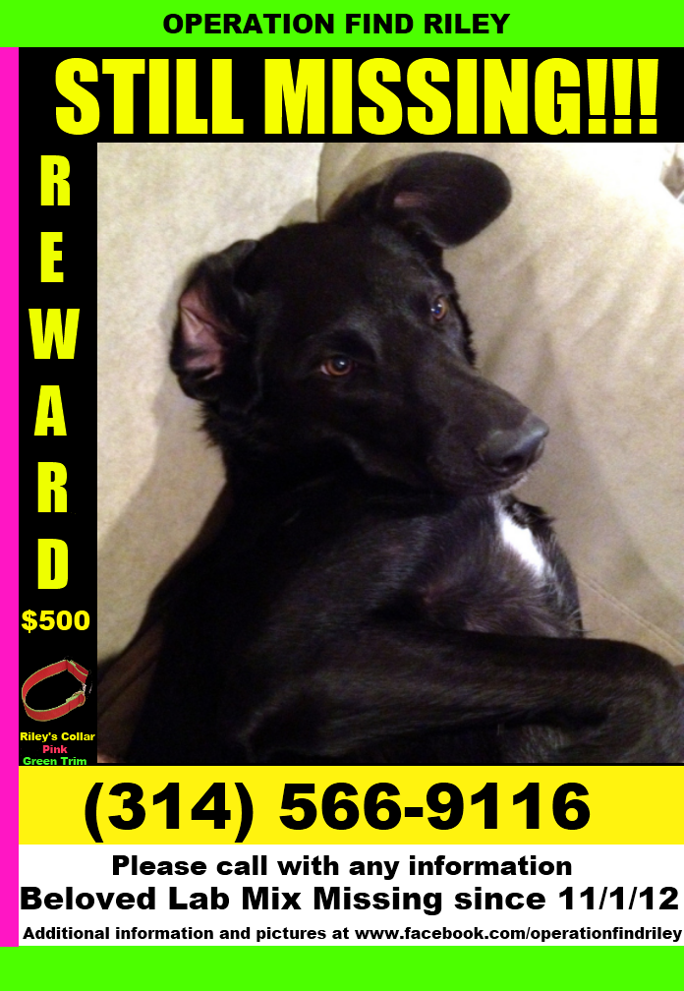
Why did I become so interested in Animal Shelter Statistics?
On November 2nd, 2012, while visiting the family farm in Macoupin County, IL my two dogs, Yoshimi and Riley, ran off chasing deer. Only one Yoshimi returned.
In the ensuing weeks I became active in local animal shelters and rescue organizations while trying to locate Riley.

Slide 3
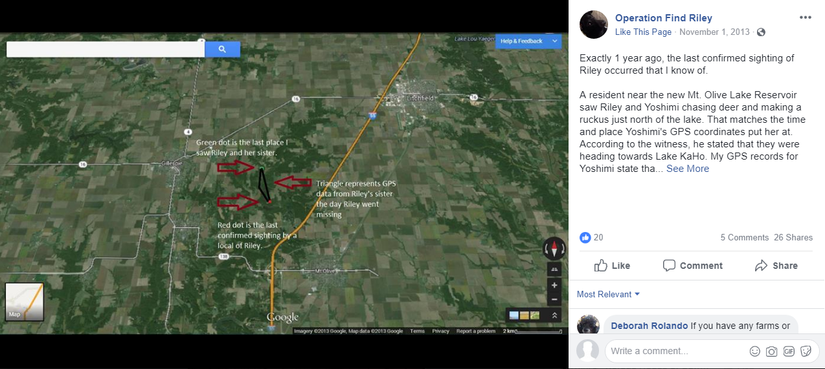
I also started my first Facebook Group https://www.facebook.com/OperationFindRiley/

Slide 4
What were the outcomes to consider during the search?
Sighted and not contained.
Need more reports of sightings to confirm where live traps can be set and to alert those in the area to be on the lookout.
Sighted and contained
Contact me directly if collar is still attached.
Routed through the typical ‘leash law’ violation protocol via local law enforcement and the AC Department to get to the County Shelter.
The finder keeps Riley for themselves.
The finder rehomes or sells the dog to family, friends, Facebook, Craigslist, etc.
The finder takes Riley to a rescue group or shelter outside of the Macoupin, Montgomery, Madison system.
Deceased
Clowns with guns
Vehicular
Dog Fighting
Freak accident

Slide 5
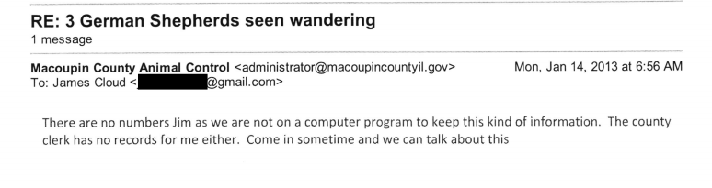
So I asked if I could get the shelter stats…

Slide 6
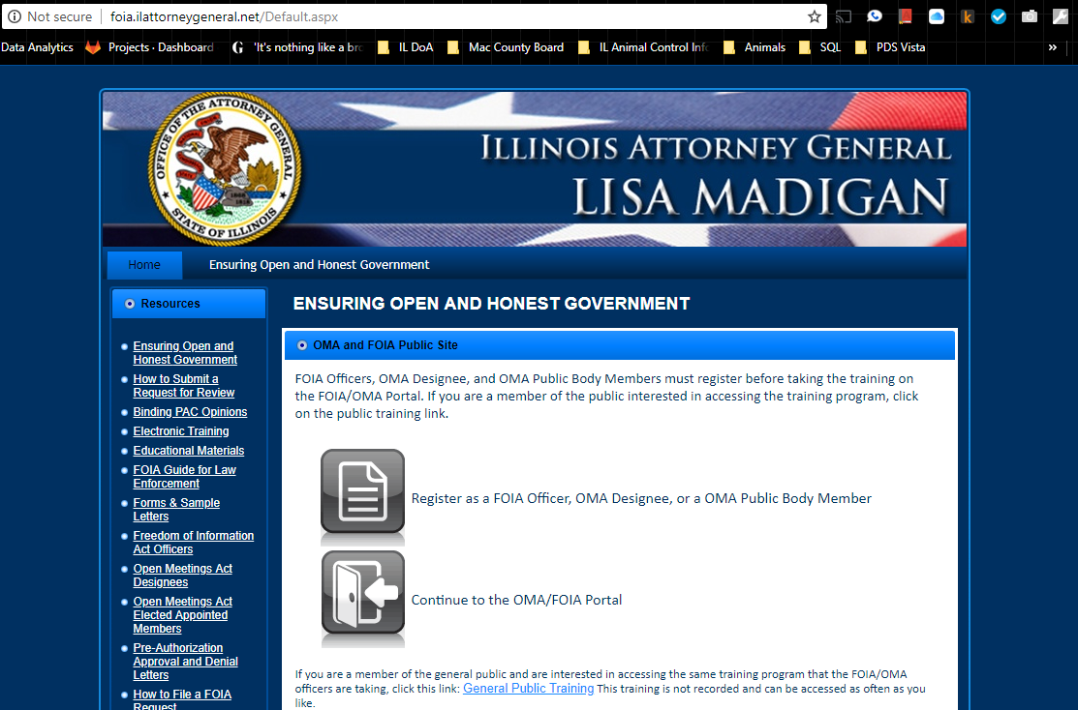
So I did what I thought any responsible citizen would do and filed a FOIA request

Slide 7
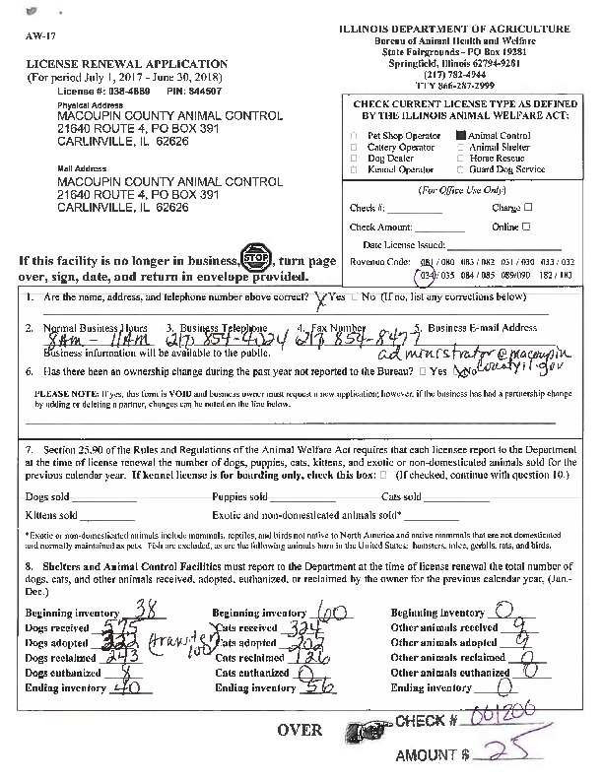
- Jim created an Excel spreadsheet with over 2,000 entries - Shelter Data composed of the animals received, adopted, euthanized, and reclaimed (RTO) broken into Dogs, Cats, and Other.
An example of Illinois Department of Agriculture Shelter License Renewal Form

Slide 8
Early Obstacles
Difficulty importing from Excel and utilizing CSV
Blank spaces and ‘invisible characters’ prevent Pandas from importing the data.
Self-submitted information
No Standardization
Working on the ‘Honor System’
Not all shelters are accounted for all 5 years.
Dataset shrank from 2400 records to 1150 records.
Sample size of data set from complete data set: ~1/3 (1150/3000)
No Cook County Data

Slide 9
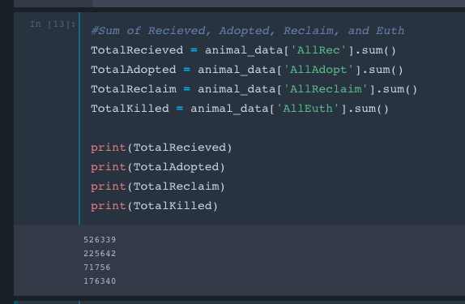
Step 1: Top-Down View
Total Animals Received = 526,339 Animals
Total Adopted = 225, 642 Animals
Total Reclaimed = 71,756 Animals
Total Euthanized = 176,340 Animals

Slide 10
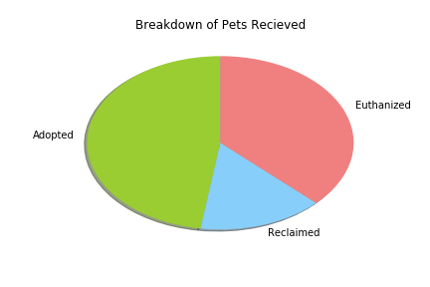
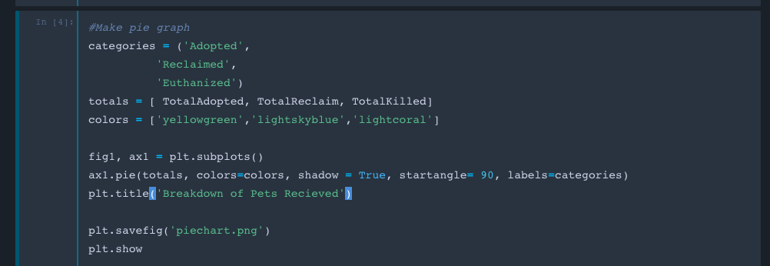
Step 2: Pie Chart

Slide 11
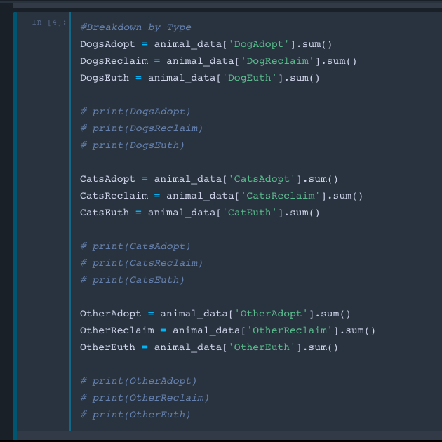
Step 3: Breakdown by Species
 | Adopted | Reclaimed | Euthanized
Dogs | 132,242 | 64,481 | 62,852
Cats | 87,496 | 6,835 | 100,565
Other | 5,904 | 440 | 12,923

Slide 12
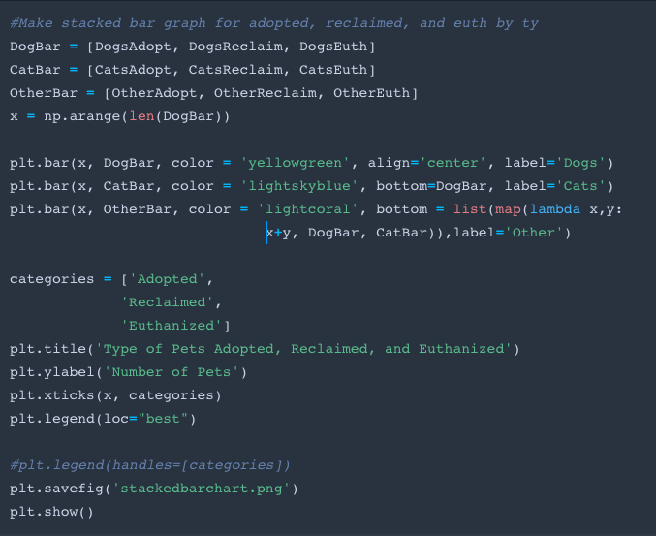
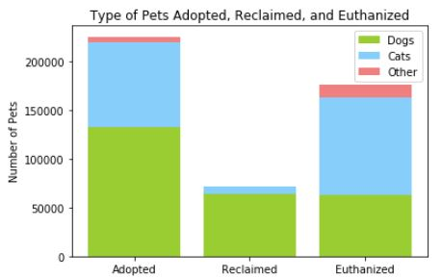
Step 4: Stacked Bar Graph

Slide 13
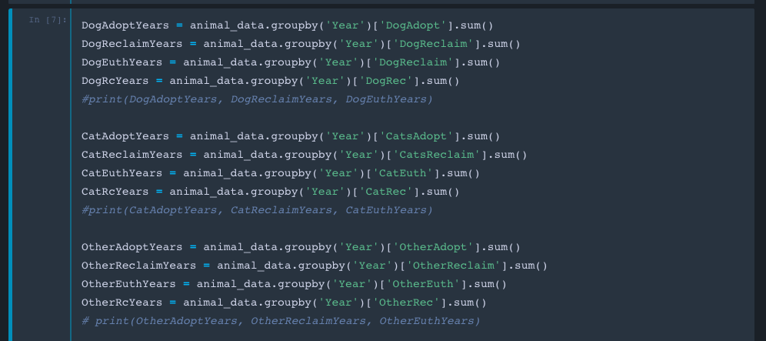
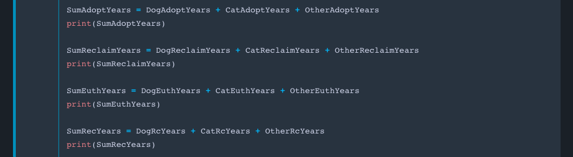
Step 5: Yearly Breakdown

Slide 14
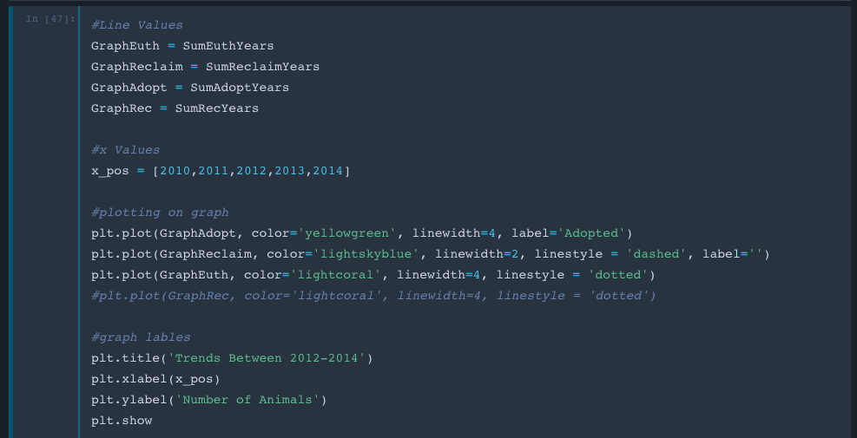
Step 6: Trendline Code

Slide 15
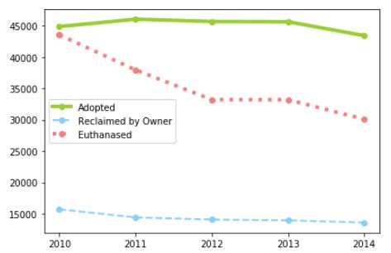
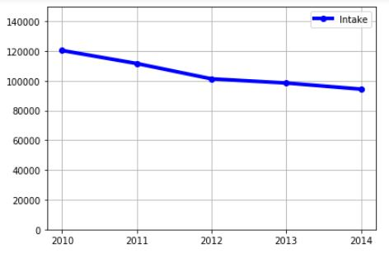
Step 7: Trendline Charts

Slide 16
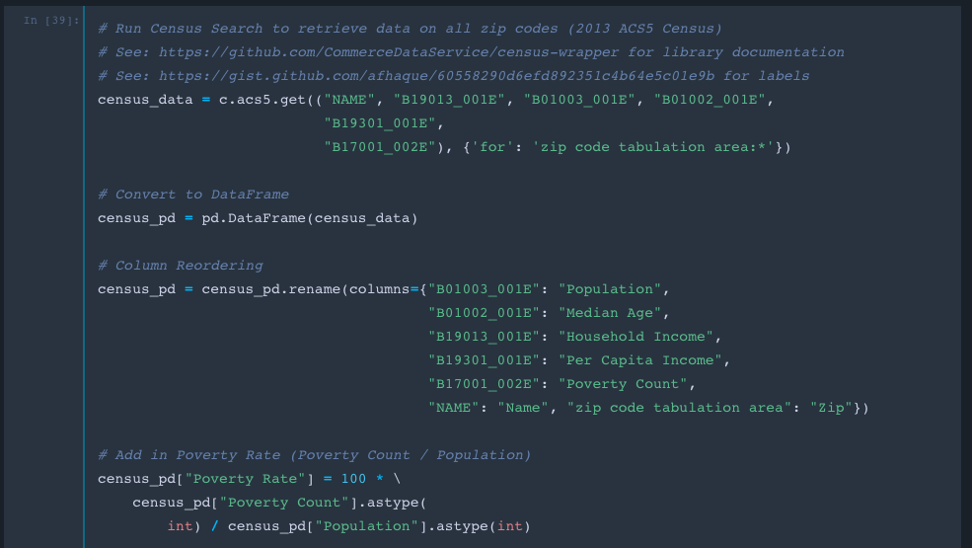
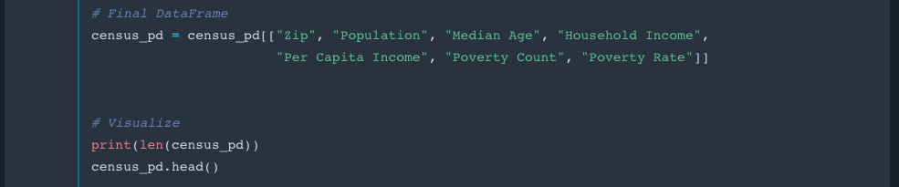
Step 8:
Census API

Slide 17
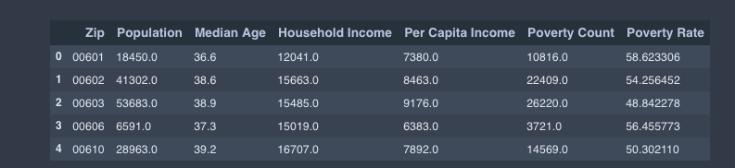
Step 9: Merge

Slide 18
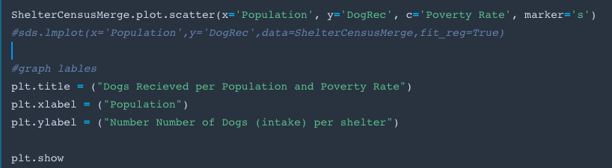
Step 10: Grey Scale and Regression

Slide 19
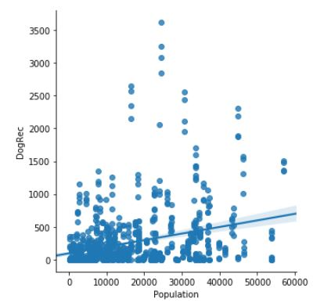
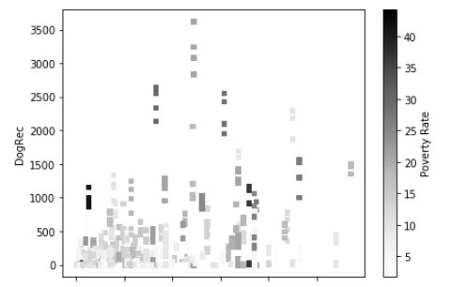
Step 11: Regression and Grey Scale Chart

Slide 20
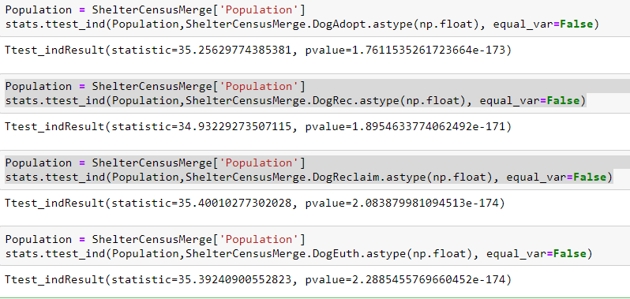
P-Values for Dog outcomes vs Population: Range (1.7 to 2.2) = low correlation Cats and Other are worse

Slide 21
Results
Hypothesis : In areas of higher population, we expect to see a higher number of animals received and adopted through animal shelters.
Null Hypothesis : There should be no correlation between population and amount of animals received and adopted through animal shelters.
Result : With a p-values greater than 1, the p-values are very high, meaning we reject our hypothesis and accept the null hypothesis – there is no correlation between population and volume of animals.

Slide 22
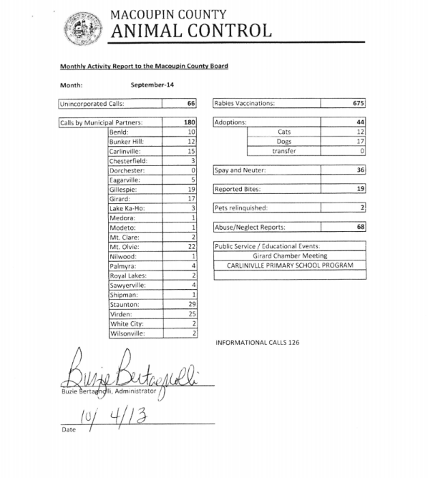
Addendum 1: It turns out Macoupin County’s Animal Control Department had a Monthly Report that was delivered to the County Board.
Only the County Board FOIA officer, who is also the County Clerk that oversees publication of the County Board meeting minutes had never of it.
Over a dozen FOIA requests with a formal complaint and appeal made with the Illinois Attorney General’s Office later…

Slide 23
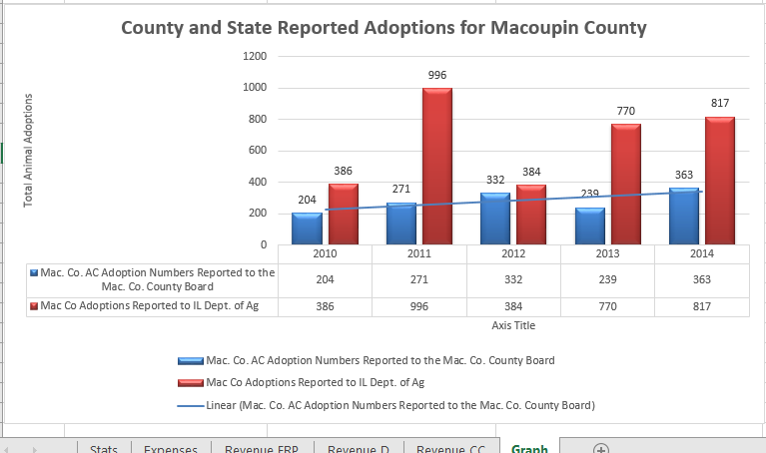
Addendum 2: County vs State Adoptions

Slide 24
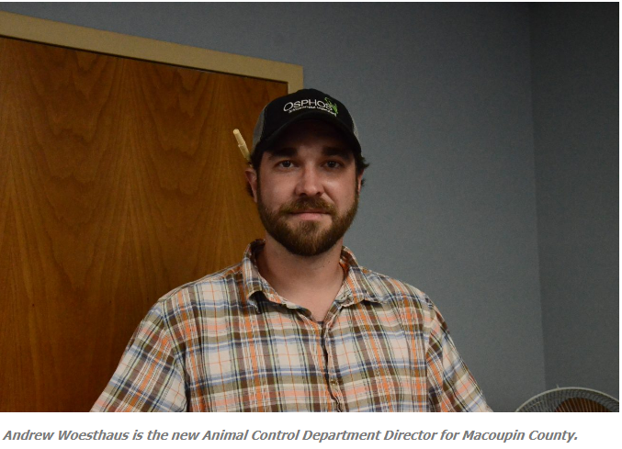
Addendum 3: The Good…

Slide 25
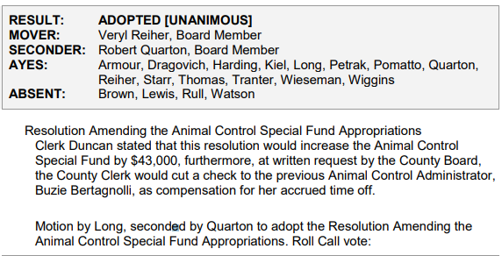
Addendum 4: The Ugly…

